Slide 1
Systemic Lupus Erythematosus (SLE)
&
Cell Signaling
Group #6
McKenna Dunn, Daniel McDonough, Tenny Oguntolu, Wesley Paul
Notes:
1. A title page that includes a descriptive title, group number, and names of all contributing group members

Slide 2
What is SLE?
Multi-Systemic
Multi-Factorial
Autoimmune
Notes:
Multi Systemic: can affect parts of the body; different organs
Multi Factorial: has many effectors that cause the SLE
AutoImmune: host’s own immune system attacks healthy tissue
Also good to memorize key stats:
-1.5 million people in the US alone have Lupus
-More likely to have lupus if you’re female (10:1)

Slide 3
Hypothesis: Can the Autoimmune Response be Halted?
Causes of SLE
Detection / Diagnosis
Treatment
Notes:
1. A clear introduction of the hypothesis/question that you are posing

Slide 4
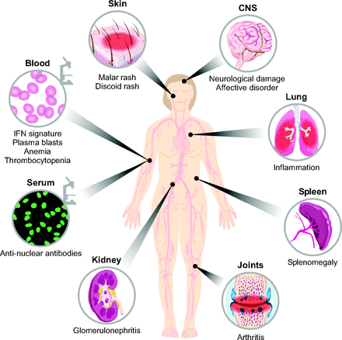
Diagnosis
Butterfly Rash (across bridge of the nose)
Blood clots / Stroke / inflammation of blood vessels
Inflammation of the heart
Memory changes & Seizures
Inflammation of lung tissue
Decreased kidney function / kidney failure
Notes:
Note how all these are not in one area -> multi systemic
According to Lupus Research Institute, 4 out of 11 criteria must be met for diagnosis of lupus

Slide 5
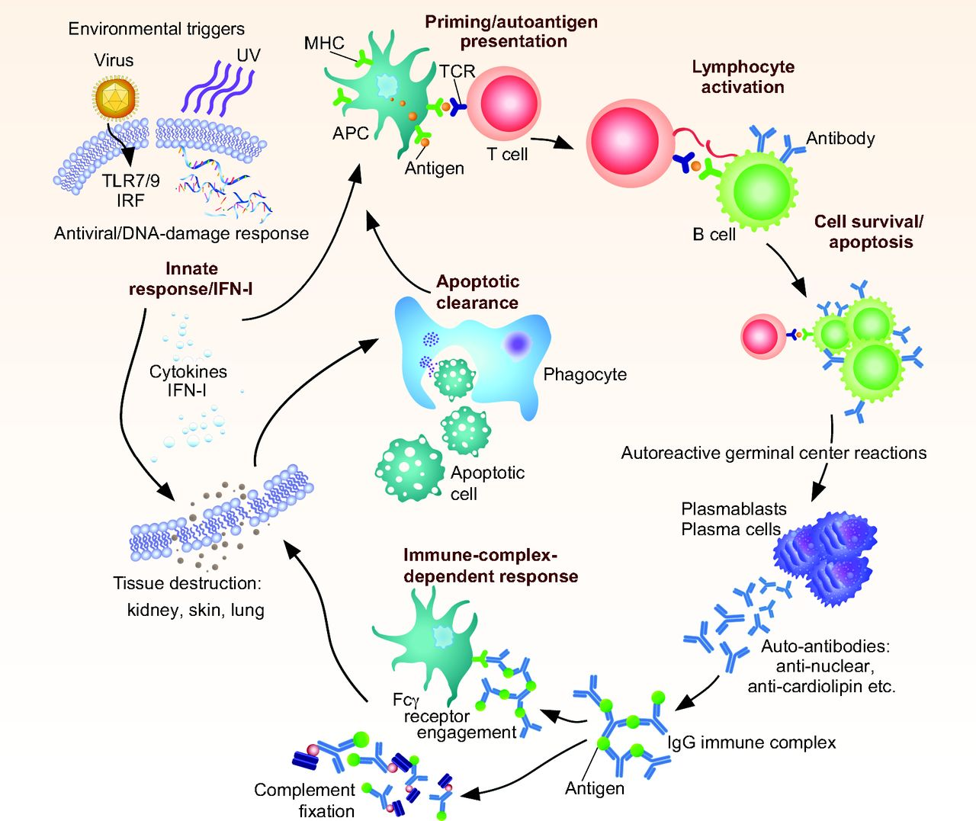
SLE Pathogenesis

Slide 6
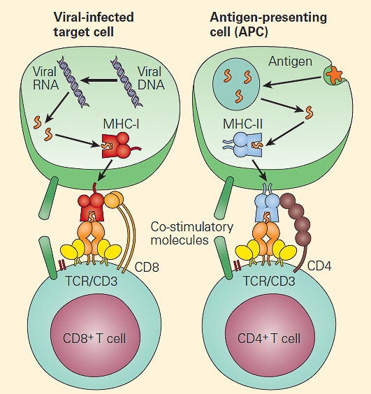
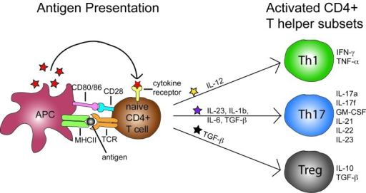
Biological Mechanism: Signal Transfer / Antigen Detection
Type 1 Interferon: a cytokine
Used to recruit more T-Cells & B-Cells
Notes:
1. Presentation and description of at least one cell biological approach/experiment from a primary research article that has illuminated/answered/supported your hypothesis or question. This component should expand upon what was included in your written assignment: providing additional description and detail to demonstrate that you understand how the experiment(s) was done (we didn’t have any so we are going with anifrolumab and signal trasfer) , and what it means. This is your opportunity to demonstrate your ability to apply your cell biology knowledge, and your skill in reading and interpreting scientific literature!

Slide 7
Anifrolumab Role in the Pathway
Anifrolumab:
A cytokine Receptor blocking protein that inhibits the binding of Type 1 Interferon.

Slide 8
Use of antibody presence for Diagnosis
Primary Diagnostic tool: Anti-double-stranded DNA (anti-dsDNA)
Proposed Diagnostic tool: Anti-nucleosome
SLE have impaired clearance of nucleosomes, inducing an antigen-driven response
These antibodies appear earlier and persist longer
Notes:
Testing used for the diagnosis of SLE measures the presence of different antibodies in the patients. The primary antibody used as in indicator for diagnosis is anti-dsDNA antibodies and used as the marker for genetic disease activity.
But they are only found in 50% of SLE patients and don’t always correlate with disease activity. This inconsistency is caused by variation of how the disease manifest itself and its biological pathway.

Slide 9
Methods of Testing/Analysis
Experiment tested sample population of SLE patients in Hospital in India.
Testing/Analysis:
Blood samples -- ELISA testing
Analysis -- Sensitivity and specificity; SLEDAI index

Slide 10
Statistical Analysis Antibody Presence
Results/Analysis:
SLEDAI Analysis: statistical significance stronger for anti-dsDNA than for anti-nucleosomes
 | Sensitivity | Specificity
Anti-dsDNA | 37.50 % | 97.5 %
Anti-nucleosomes | 47.59 % | 100 %
Notes:
Say what this says about the biological process of SLE…

Slide 11
Experiment: Anifrolumab & Potential Treatment
Context:
Treatment was administered every 4 weeks with the final dose administered at week 48.
The primary and secondary efficacy measures were assessed at week 24 and week 52, respectively.
All patients were required to complete 12 scheduled monthly visits + 1 follow up.
Randomization was stratified by type I IFN gene signature (IFN high or IFN low),
dosage of oral corticosteroids (<10 mg/day or ≥10 mg/day of prednisone or equivalent), and SLEDAI‐2K score (<10 or ≥10) at screening.
Methods:
IFN gene signature was determined at a central laboratory using an analytically validated 4‐gene (IFI27, IFI44, IFI44L, and RSAD2) quantitative polymerase chain reaction (qPCR)–based test from patients’ whole blood.
Notes:
· Enough detail so that your audience understands HOW the experiment was done (context, methods, materials), and WHAT the experiment shows (results)
Other notes:
Anifrolumab has about 1/10 error rate in binding

Slide 12
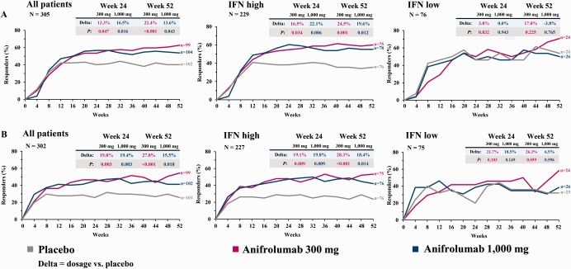
Results: Anifrolumab & Potential Treatment
Richard, Furie. Munther, Khamashta. Joan T. Merrill. Victoria, P. Werth. Kenneth, Kalunian. Philip, Brohawn. Gabor, G. Illei. Jorn, Drappa. Liangwei,Wang. Stephen, Yoo. Anifrolumab, an Anti–Interferon‐α Receptor Monoclonal Antibody, in Moderate‐to‐Severe Systemic Lupus Erythematosus. Arthritis Rheumatol. 2017 Feb; 69(2): 376–386.
Notes:
A data figure from a primary research article, that illustrates or supports the concept (with citation indicated on the slide)
Efficacy results over time in patients with systemic lupus erythematosus (SLE) receiving anifrolumab 300 mg, anifrolumab 1,000 mg, or placebo. Treatment was given every 4 weeks from week 1 to week 48.
A, Proportion of patients achieving an SLE Responder Index response over time in the modified intent‐to‐treat (ITT) population and in the interferon (IFN)–high and IFN‐low subsets.
B, Proportion of patients achieving a British Isles Lupus Assessment Group 2004–based Combined Lupus Assessment response over time in the modified ITT population and in the IFN‐high and IFN‐low subsets.

Slide 13
Conclusion: Anifrolumab & Potential Treatment
Compared with placebo…
“Anifrolumab treatment resulted in significantly greater rates of improvement across a broad range of composite and organ‐specific disease activity measures as well as in the achievement and maintenance of low disease activity.
This is compelling evidence that blocking Type 1 Interferon Receptor is a promising strategy in the treatment of SLE.”
Richard, Furie. Munther, Khamashta. Joan T. Merrill. Victoria, P. Werth. Kenneth, Kalunian. Philip, Brohawn. Gabor, G. Illei. Jorn, Drappa. Liangwei,Wang. Stephen, Yoo. Anifrolumab, an Anti–Interferon‐α Receptor Monoclonal Antibody, in Moderate‐to‐Severe Systemic Lupus Erythematosus. Arthritis Rheumatol. 2017 Feb; 69(2): 376–386.
Notes:
Conclusions and interpretation: how the figure/experiment you presented supports/answers your hypothesis or question.

Slide 14
Summary
Not one sufficient diagnostic method.
Initially caused by external factors, few actually known
Current research is not sufficient to determine if the autoimmune response to be halted.
More research required.
Increase quality of life of many people!
Notes:
A clear summary of how this cell biological research has impacted, will impact, or be impacted by, the topic you have chosen to study.
What areas of research can be studies further to continue to answer our hypothesis?

Slide 15
Information References
Dörner, Thomas. Giesecke, Claudia. Lipsky, Peter E. 2011. Mechanisms of B cell autoimmunity in SLE. Arthritis Research & Therapy. 12;13(5): 243.
Saigal R, Goyal LK, Agrawal A, Mehta A, Mittal P, Yadav RN.. 2013. Anti-nucleosome antibodies in patients with systemic lupus erythematosus: potential utility as a diagnostic tool and disease activity marker and its comparison with anti-dsDNA antibody. J Assoc Physicians India. Jun;61(6):372-7
Anolik, J. and Aringer, M. (2005). New treatments for SLE: cell-depleting and anti-cytokine therapies. Best Practice & Research Clinical Rheumatology, 19(5), pp.859-878.
Bubier, J., Sproule, T., Foreman, O., Spolski, R., Shaffer, D., Morse, H., Leonard, W. and Roopenian, D. (2009). A critical role for IL-21 receptor signaling in the pathogenesis of systemic lupus erythematosus in BXSB-Yaa mice. Proceedings of the National Academy of Sciences, 106(5), pp.1518-1523.
Z-G Li, R Mu, Z-P Dai, X-M Gao. 2005. T cell vaccination in systemic lupus erythematosus with autologous activated T cells. Lupus. Nov;14(11):884-9.
R. H. B. Benedict, J. L. Shucard, R. Zivadinov, D. W. Shucard. 2008 Neuropsychological Impairment in Systemic Lupus Erythematosus: A Comparison with Multiple Sclerosis. Neuropsychol Rev. Jun; 18(2): 149–166.
Richard, Furie. Munther, Khamashta. Joan T. Merrill. Victoria, P. Werth. Kenneth, Kalunian. Philip, Brohawn. Gabor, G. Illei. Jorn, Drappa. Liangwei,Wang. Stephen, Yoo. Anifrolumab, an Anti–Interferon‐α Receptor Monoclonal Antibody, in Moderate‐to‐Severe Systemic Lupus Erythematosus. Arthritis Rheumatol. 2017 Feb; 69(2): 376–386.
Crampton, Steve P. Morawski, Peter A. Bolland, Silvia. Linking susceptibility genes and pathogenesis mechanisms using mouse models of systemic lupus erythematosus. Disease Models & Mechanisms 2014 7: 1033-1046

Slide 16
Figure References
1&2: Kum, Cavit & Sekkin, Selim. The Immune System Drugs in Fish: Immune Function, Immunoassay, Drugs. Recent Advances in Fish Farms. Research Gate. Nov. 11 (4) 170-216(2011)
3&4: Rodgers, Jane M. Miller, Stephen D. Cytokine Control of Inflammation and Repair in the Pathology of Multiple Sclerosis Yale J Biol Med. 2012 Dec; 85(4): 447–468.
5: Richard, Furie. Munther, Khamashta. Joan T. Merrill. Victoria, P. Werth. Kenneth, Kalunian. Philip, Brohawn. Gabor, G. Illei. Jorn, Drappa. Liangwei,Wang. Stephen, Yoo. Anifrolumab, an Anti–Interferon‐α Receptor Monoclonal Antibody, in Moderate‐to‐Severe Systemic Lupus Erythematosus. Arthritis Rheumatol. 2017 Feb; 69(2): 376–386.
Notes:
1. A final slide with the citations listed (not to present, but for my reference)

